Slide 1

State of the Insurance Market
for FL Community Associations
Erika Pfeiffer
Vice President, Commercial Lines
D: (954) 686-6595 | M: (954) 401-6132
Erika_Pfeiffer@ajg.com | Erika.Pfeiffer@assuredpartners.com | AJG.com

Slide 2
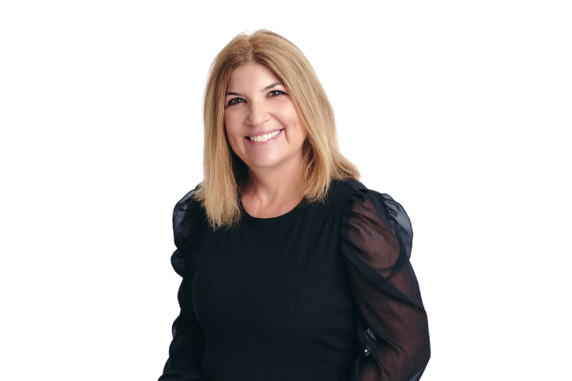
Meet the Presenter
Erika Pfeiffer is a Vice President in Gallagher’s Commercial Lines division, specializing exclusively in community associations. She brings over 25 years of industry expertise, helping communities navigate the evolving insurance landscape. Erika is a graduate of the University of Georgia, where she earned her BBA with a major in Risk Management and Insurance.

Slide 3

Agenda
Association Insurance Basics
State of the Market Update
Exclusions and Warrants
Roof Age and Mandatory Replacement
What to Expect for 2026
Coinsurance Example
What Can be Done to Reduce Rates
Insurance Legislation
Q&A
Notes:
Go through Agenda:
Association Insurance Basics
State of the Market Update
What to Expect for 2022
What Can be Done to Reduce Rates
How to communicate and plan for increases
Q&A

Slide 4
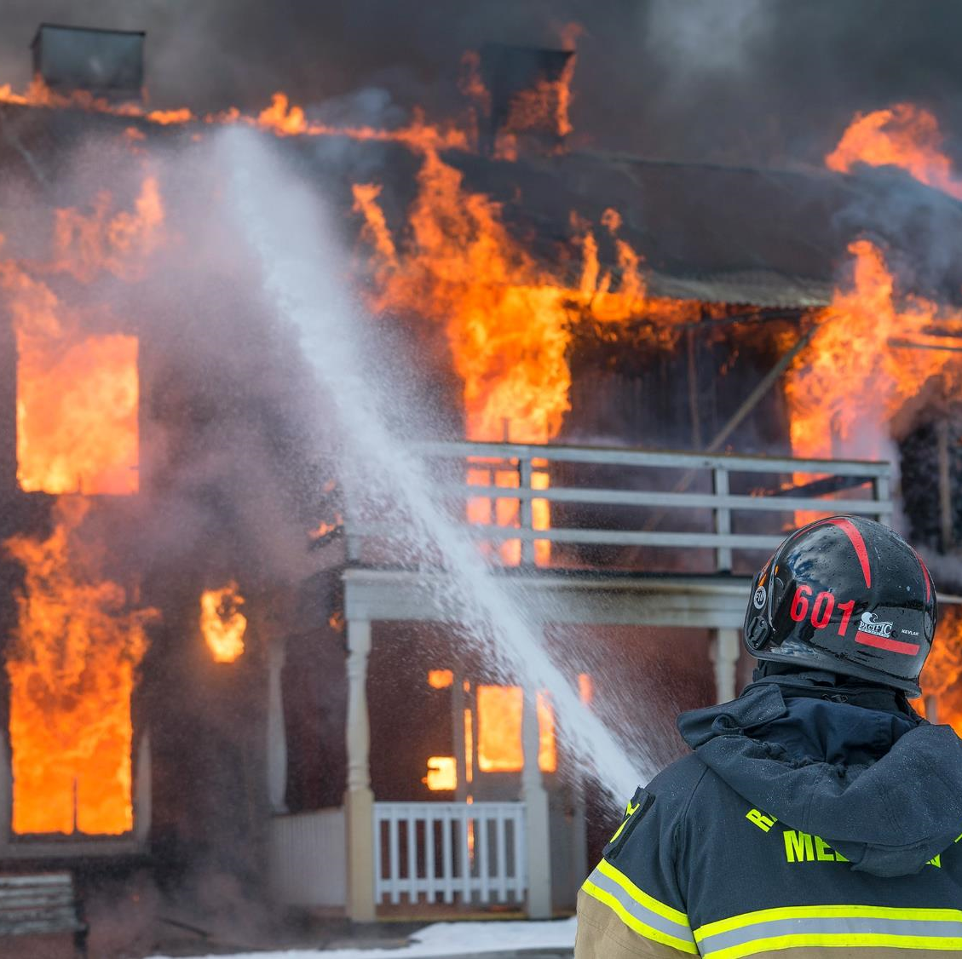
Association Insurance Basics
What insurance must an association carry? Can they be Self Insured?
What is the role of the Insurance Agent?
How is Association Insurance “Shopped” or “Bid Out”?
How does the Association know they’re getting the best deal available to them?
What is the difference between an “Admitted” and “Non-Admitted” carrier?
Notes:
Other Questions:
What insurance must an association carry? Can they be Self Insured?
What is the role of the Insurance Agent?
How is Association Insurance “Shopped” or “Bid Out”
How does the Association know they’re getting the best deal available to them?
What is the difference between an “Admitted” and “Non-Admitted” Carrier
What does “surp

Slide 5

  State of the Market Update and Common Questions
Are increases starting to slow down?
What is the impact of inflation on replacement cost values?
Are more carriers entering the market?
What impact will the 2025 hurricane season have on property rates in 2026?
Are property deductible options improving?
How has premium financing been impacted by high interest rates?
Can we combine policies across multiple neighboring associations to save money?
Are other lines besides property being impacted?
  D&O, General Liability, Umbrella/Excess Liability
Notes:
Natural Disasters: Hurricane Irma, Dorian, Ida. Tornados and Derechos in the Midwest, & California wildfires
Reinsurance: can be thought of as insurance for insurance companies. Reinsurance allows insurance companies to only claim a portion of their losses
Capacity Restrictions
Social Inflation
Several new carriers entering the market after many had pulled out of the state in prior years
Carrier are re-underwriting all associations since Surfside Collapse
Umbrellas are heavily impacted
Appraisal Values are way up, in addit

Slide 6


Exclusions –What are they and why they matter
Concerning Exclusions:
  Animal Bite
  Assault and Battery
  Firearms
  Abuse and Molestation
  Water Damage
  Liquor
Other Warrants – Requirements on the Association that if they’re not followed there is no coverage
  Typically requirements of safety controls and contracts

Slide 7

Roof Age and Mandatory Replacement
Why do Insurance Companies care about Roof Age?
Can we be declined for Insurance due to Roof Age?
Difference between “Actual Cash Value” and “Replacement Cost” coverage for roofs?
Can an inspector give a report to extend the useful life of the Roof?
What should we do if we get cancelled due to roof age?
Do all carriers look at roof age the same?

Slide 8
  What To Expect– Property Coverage
  (Condo Perspective)
Valuations – Under scrutiny and construction costs are skyrocketing. New appraisals are still being required.
Changes in Terms:
  Seeing 2% and 3% wind deductibles now in some cases, 5% still most common
  40 Year Recertification Reports
    If required work is not complete, there may be trouble getting quotes from additional property carriers
  Roof Inspections
Premium Changes:
  Property premiums decreasing roughly 10-15% on average lately if no claims
    Some communities seeing even larger decreases, especially those with new roof
    Premium changes come from two factors – 1. Rate of insurance cost per dollar of insured value 2. Increase in replacement cost
Declines – Condos that have EIFS / loss affected or other items are still difficult and see declines from some carriers
Condos – Majority of your premium is made up of the property policy with general liability being second largest item.
Notes:
Valuations are under scrutiny and construction costs are skyrocketing. New appraisals are being required.
What happens if you’re undervalued and you have a total loss?
Re-Underwriting – Almost all accounts are being re-underwritten even when staying with the same carrier
Changes in Terms:
Increases in deductibles
Exclusions
Hurricane wording changing to “named storm” to include tropical storms
40 Year Certification Reports being requested
Condos over 25 years / that have EIFS / loss affected or other items are starting to become harder and see more outright declines than in years past where price would allow carriers to right.

Slide 9
  What To Expect– General Liability, D&O, Umbrella
  (HOA Perspective)
Supply of Carriers – Fewer admitted options in FL for each line of coverage and have not yet seen new influx of carriers like we have with property.
Premium Changes:
  General Liability – Roughly 5-15% increases on average for those without claims, with claims this could be more depending on type and severity.
    Liability carriers look at claims from the past 5 years, so if you had a big claim from before and no new claims, then you could see an improved rate.
  Directors and Officers – Similar to general liability, roughly 5-20% increases on average.
  Umbrella – Umbrella market has become very difficult as there are very few carriers operating in FL. Premium changes have varied widely recently seeing anywhere from 10-100%+ increases.
Exclusions – More exclusions and sub-limits being included in general liability and umbrella policies.
HOAs:
  If no clubhouse or only small buildings, majority of your premium is made up of these policies instead of property coverage.

Slide 10
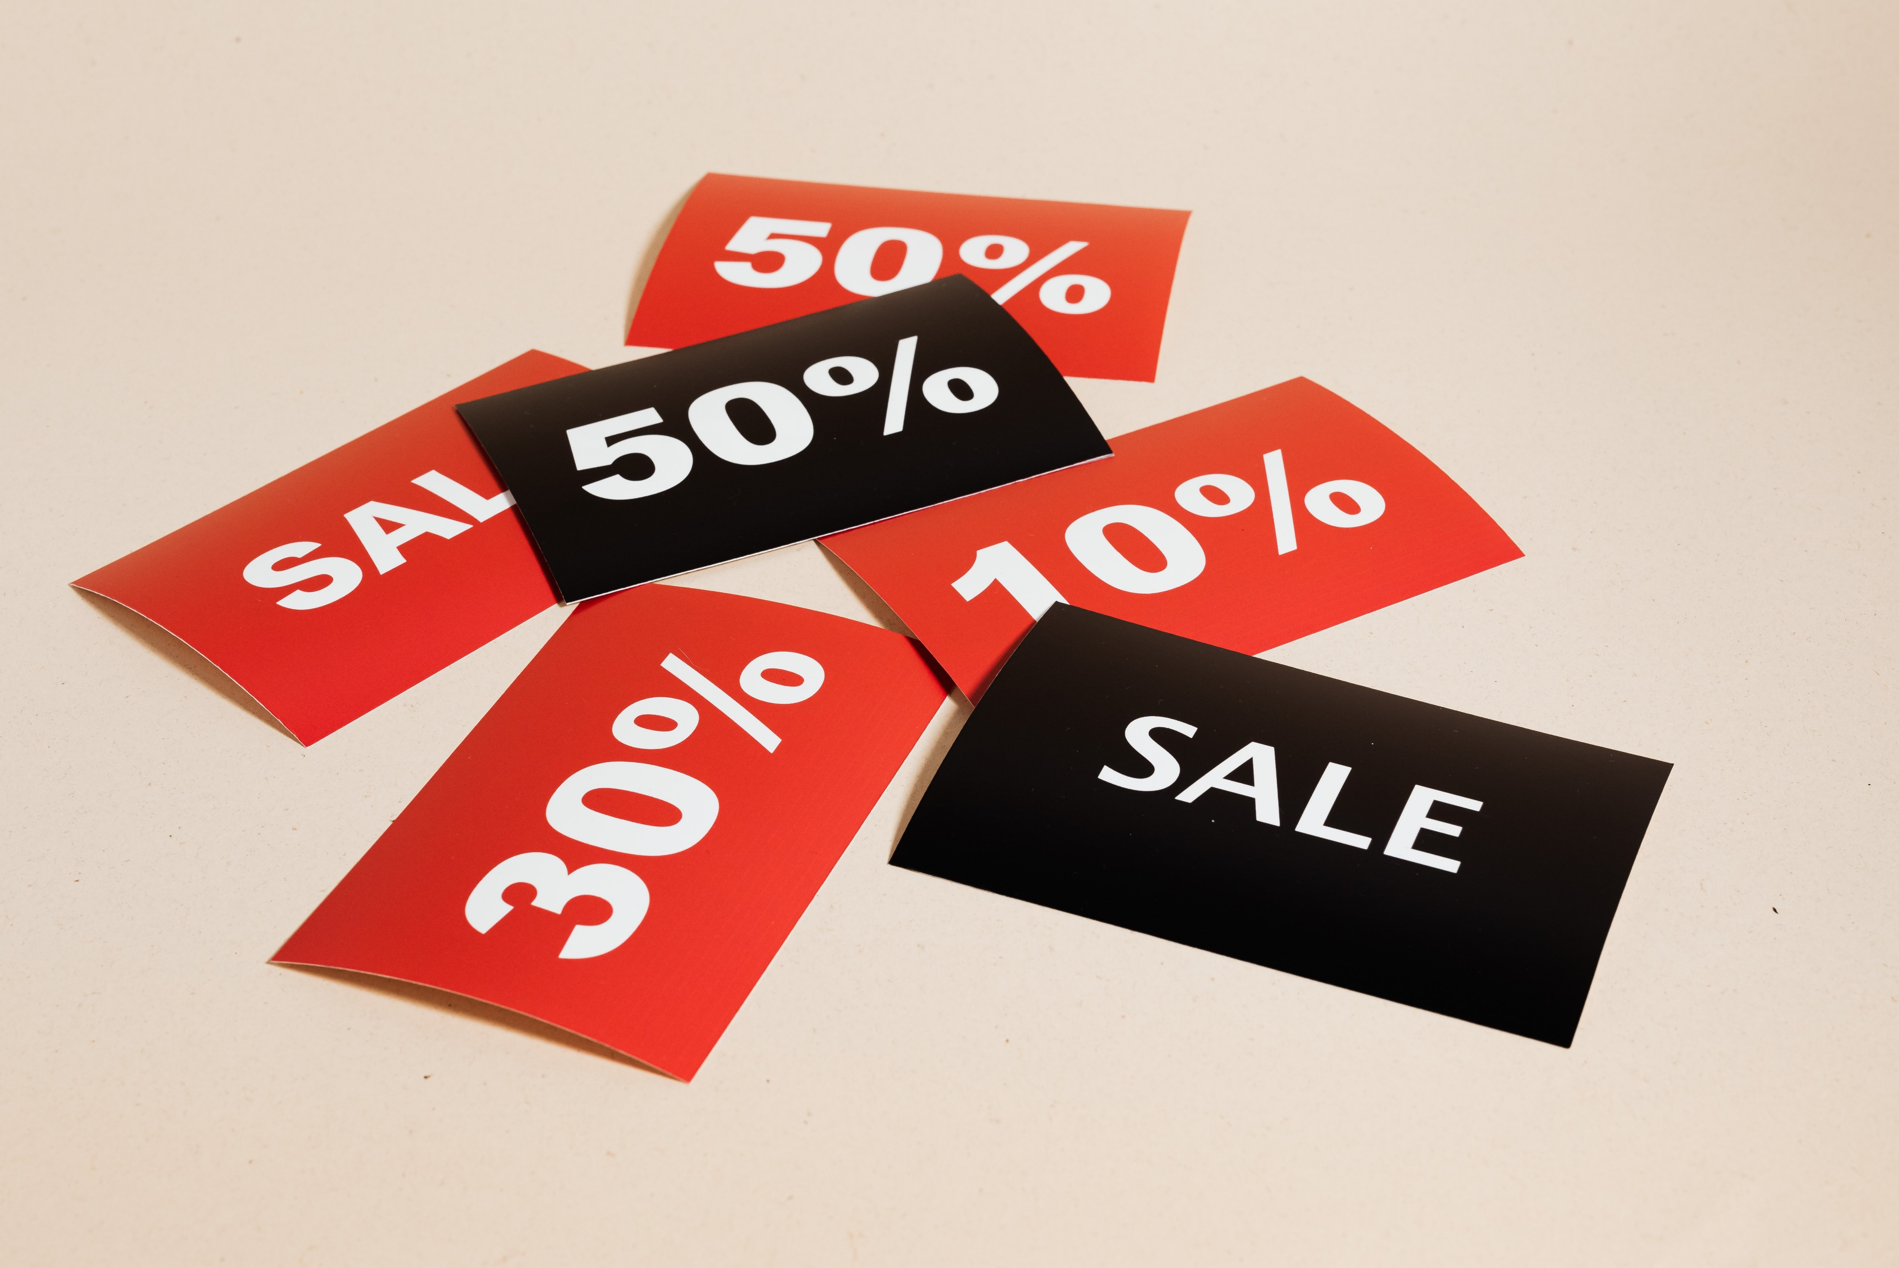
  How Can we reduce Rates (or at least reduce increases)?
What building improvements can we make to bring down rates?
Which improvements have the biggest impact?
Do we need to insure for full replacement value? YES.
What should we look for when evaluating policy options?
Notes:
Routinely walk properties to ensure safety hazards are addressed quickly. Loss Prevention team?
Activities - are they worth the additional exposure?
Newer Roofs
All Impact (or Shuttered openings)
Increasing Deductibles
Tweaking limited on Law & Ordinance, playing with deductible
Accurate information, risk modeling, improvements

Slide 11

Q & A
Questions?

Slide 12
Thank You
Erika Pfeiffer
Vice President, Commercial Lines
D: (954) 686-6595; M: (954) 401-6132
Erika_Pfeiffer@ajg.com | Erika.Pfeiffer@assuredpartners.com | AJG.com

